Slide 1
Low Power System Design (PVL 207)

Slide 2
Supply Voltage Scaling for Low Power
Introduction
Device feature size
Voltage scaling Approaches
Challenges in Voltage Scaling Approaches
Architectural Level Approaches
Parallelism
Pipelining
Architectural level transformation

Slide 3


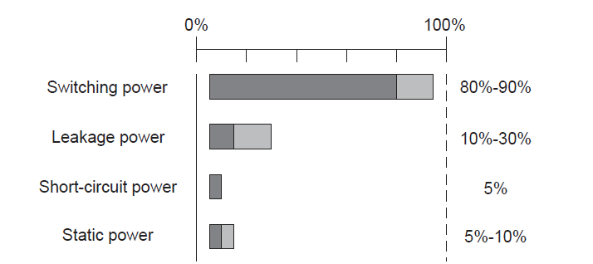
Introduction
Pleakage = Vdd. Ileakage
Contribution of Various Sources of Power Dissipation

Slide 4
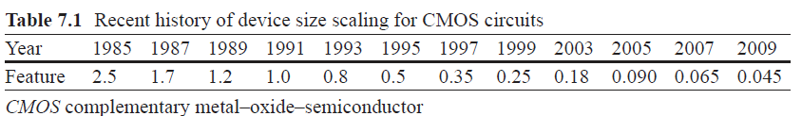
History of device size scaling for CMOS

Slide 5
Different Approaches for Supply Voltage Scaling
Static Voltage Scaling: Different blocks or subsystems are given different fixed voltages.
Multilevel Voltage scaling (MVS): This is an extension of SVS where the supply voltage is switched between two or few fixed voltages.
Dynamic Voltage and Frequency Scaling (DVFS): This is an extension of MVS where a large number of voltage levels are dynamically applied for different workloads.
Adaptive Voltage Scaling (AVS): This is an extension of the DVFS where a control loop is used to adjust voltage and frequency for changing workload.

Slide 6
Challenges of Supply Voltage Reduction
A factor of two reduction in supply voltage yields a factor of four decrease in energy.
Theoretical lower limit of supply voltage for CMOS circuit is 0.2V.
As supply voltage is lowered delay increases leading to dramatic reduction in performance.
Objective of voltage scaling is to scale Supply Voltage without compromise in performance.

Slide 7
Challenges….
Power supply reduction helps digital circuits for power consumption but hurts analog voltage swing which should not be reduced.
Inherent transistor voltage gain decreases with reduced size technology, this implies larger number of stages to compensate the overall voltage gain.
Threshold voltages do not reduce linearly with size of technology, making the design with low VDD harder for analog circuits
Technology forecast

Slide 8
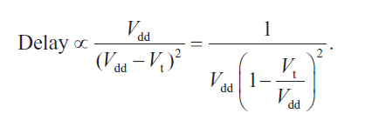
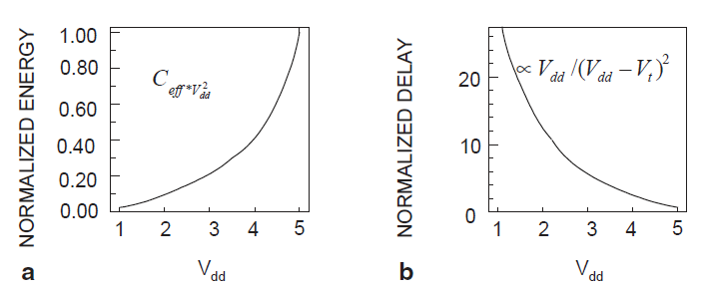
Challenges in Supply Voltage Scaling
a) Variation of normalized energy with respect to supply voltage
b) variation of delay with respect to supply voltage

Slide 9
Architectural Level Approaches for Voltage Scaling

Slide 10
Parallelism
Parallel processing can be important technique for reducing power consumption in CMOS circuits.
Key approach is to trade area for power while maintaining the same throughput.
In simple terms, if the supply voltage is reduced by half, the power is reduced by one-fourth and performance is lowered by half.
The loss in performance can be compensated by parallel processing.

Slide 11

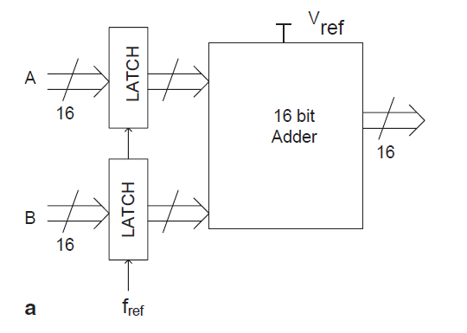
Parallelism for Low Power
Architectural Level Approaches
A 16 bit Adder

Slide 12
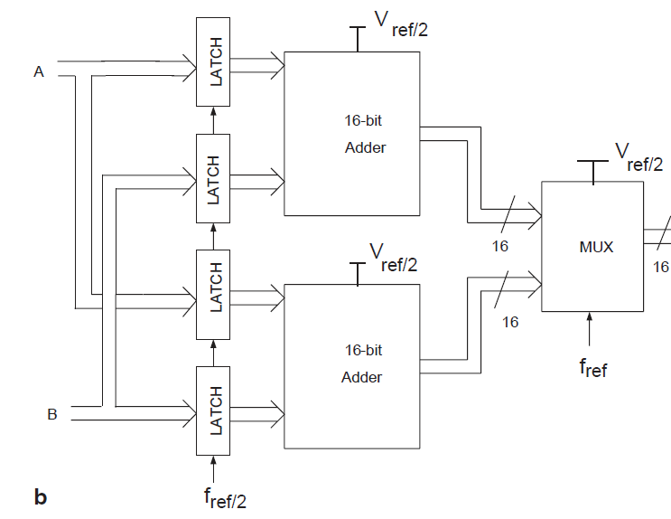
Parallel architecture of the 16-bit adder. MUX multiplexer

Slide 13
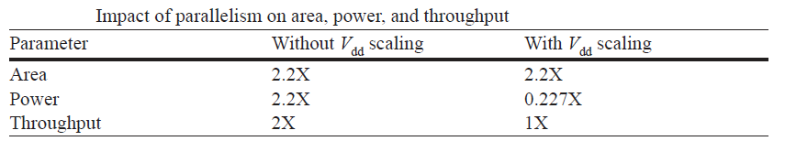


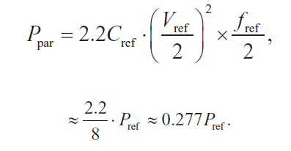

Slide 14
Multi core for low power

Slide 15
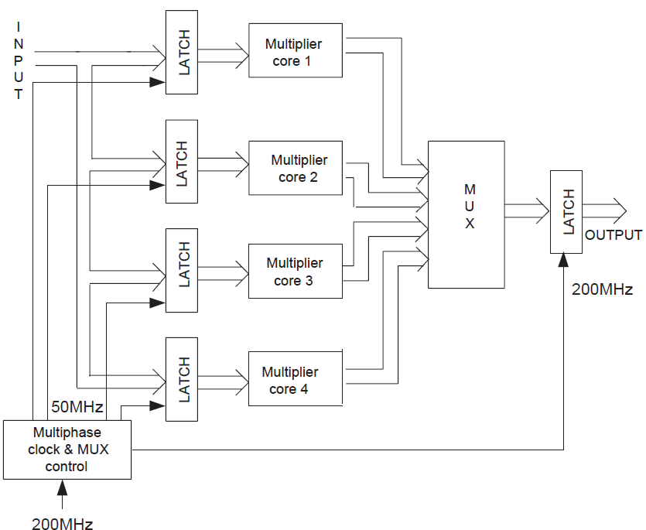
Multi-Core for Low Power
A four-core multiplier architecture

Slide 16
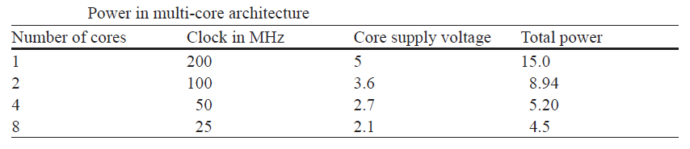
Multi-core for Low Power
Important Issue : Increase in overhead, Limit on the supply
voltage, Increase in leakage current
This is the basis of the present day multi-core commercial processors
introduced by Intel, AMD and other Processor manufacturers
Thread level parallelism is explained in multi-core architectures to increase throughput of the processors.

Slide 17
Pipelining
Pipelining for Low Power
Voltage scaling through optimal transistor sizing
Voltage scaling using high level transformation

Slide 18
Basic Concept
What is pipelining?
It is an implementation technique where multiple tasks are performed in an overlapped manner.
Where can it be implemented?
It can be implemented where a task can be divided into two or more subtasks which can be performed independently.

Slide 19
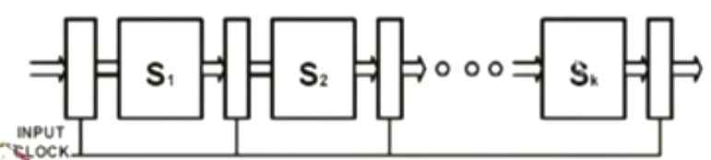
Pipeline Implementation
How it is implemented?
Different subtasks are performed by different hardware blocks known as stages.
The result produced by each stage is temporarily buffered in latches and then passed on to the next stage.

Slide 20
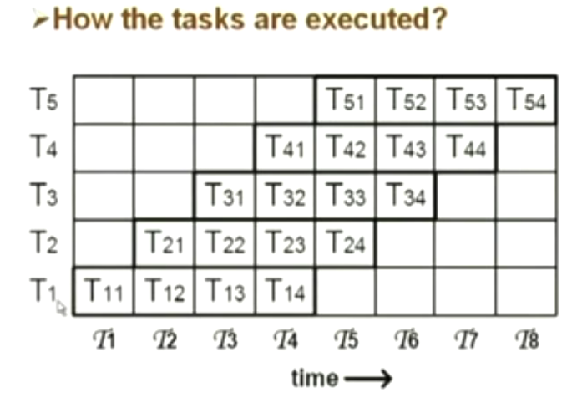

Slide 21
Pipeline Performance parameters
Clock period
Frequency
Speedup: nk/k+(n-1)
Throughput: Number of tasks that can be completed per unit time.

Slide 22
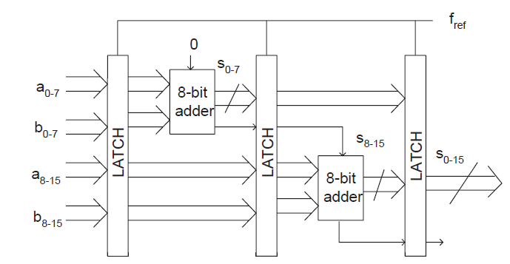

Pipelining for Low Power
Pipelined realization 16-bit adder

Slide 23
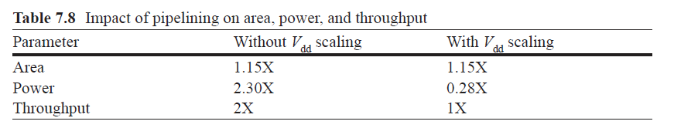

Slide 24
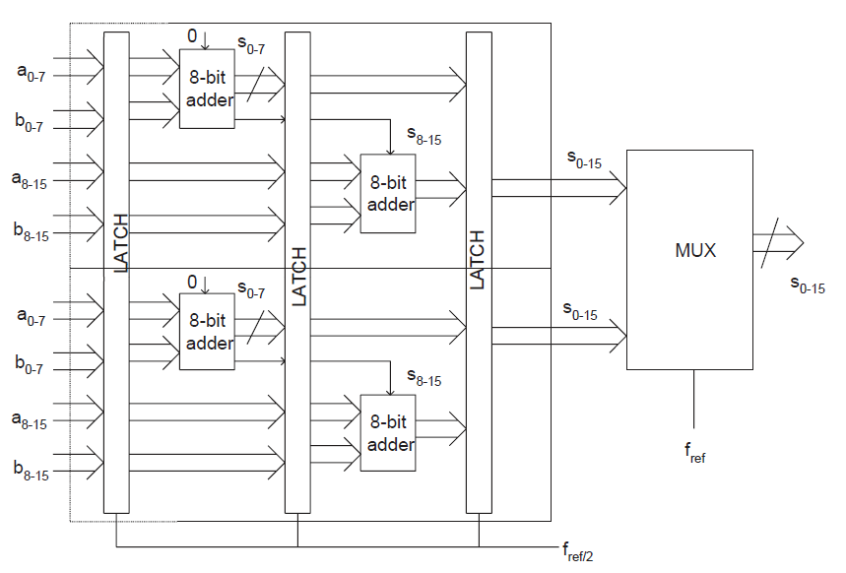
Combining Parallelism with Pipelining
Parallel-pipelined realization of 16-bit adder. MUX multiplexer

Slide 25

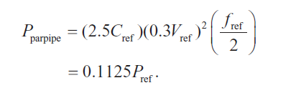
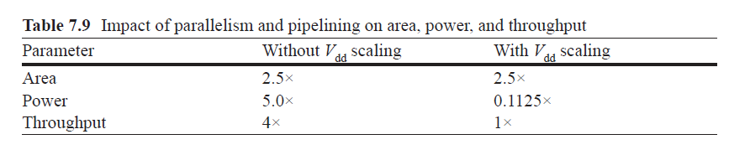

Slide 26
Optimal Transistor Sizing for Low Power

Slide 27
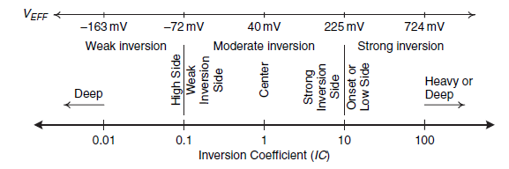

Inversion Coefficient
I0 = Technology current which is fixed for a particular technology
0.64 uA for nMOS and 0.135 uA for PMOS (0.18 um Technology)
IC

Slide 28
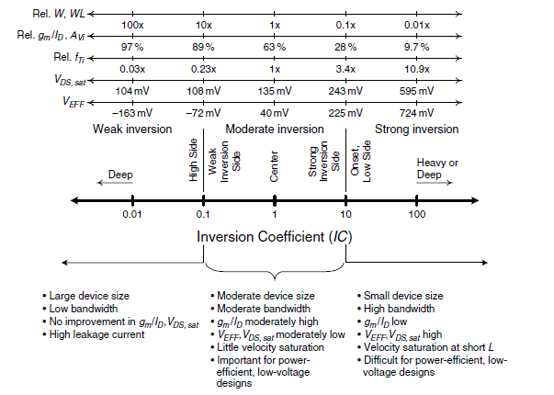

Slide 29
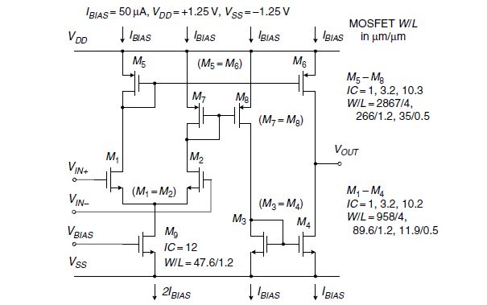

Slide 30
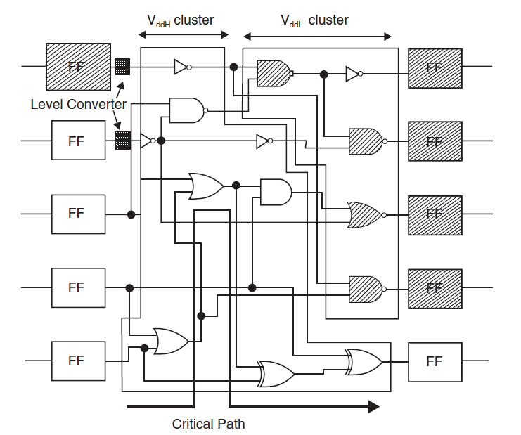
Multilevel Voltage Scaling
Clustered voltage scaling

Slide 31
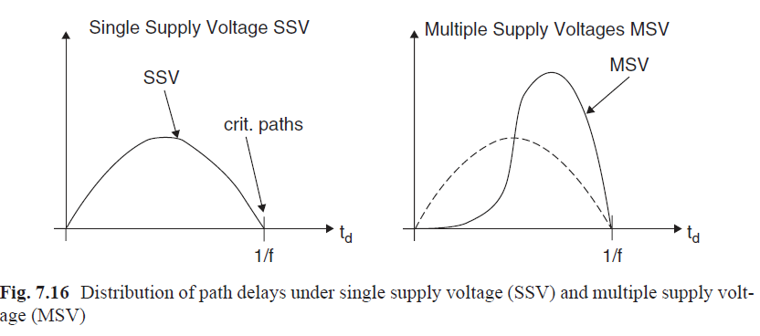

Slide 32
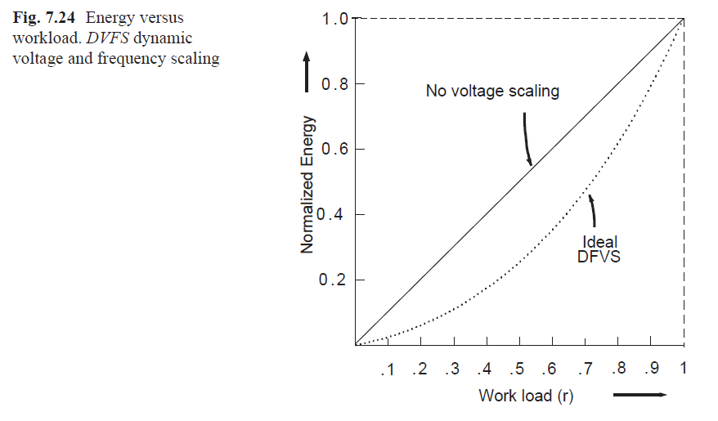

Dynamic Voltage and Frequency Scaling

Slide 33
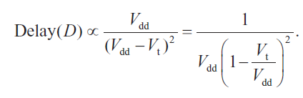
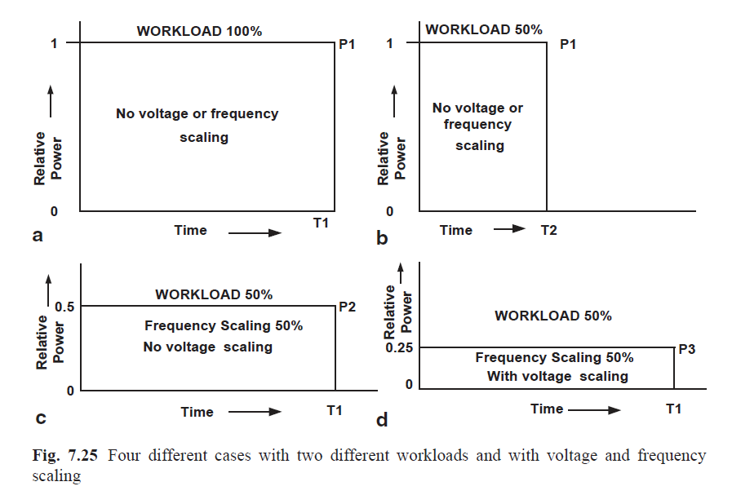

Slide 34
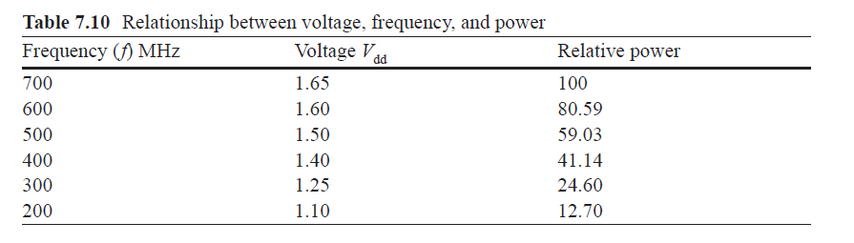

Slide 35
DVFS with Varying Work Load
Variable voltage processor μ( r)
Variable voltage generator V( r)
Variable frequency generator f( r)

Slide 36
Variable Voltage Processor μ(r)
Frequency change in steps of 33 MHz
Voltage change in steps of 25 mV
Up to 200 frequency/voltage change per second

Slide 37
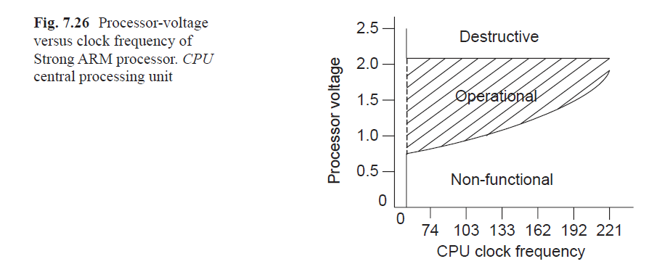

Slide 38
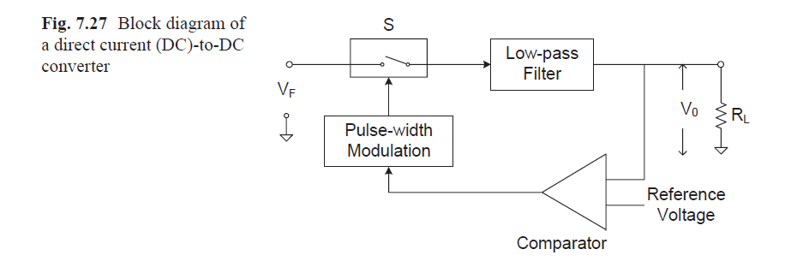

Slide 39
Variable Voltage Generator V(r)

Slide 40
References
Ajit Pal, “Low power VLSI Circuits and Systems” Springer, 2015.

